Slide 1
W3 D5 Webscrapping
Sivasankar Arul

Slide 2
Web Scraping - Is it legal
Checking a website’s robots.txt file for rules about scraping. This file specifies what parts of the website are open to automated tools and what are off-limits.
Avoiding overloading a website’s server with excessive requests, which can disrupt its normal operation.
Ensuring compliance with the website’s terms of service and any applicable laws, like copyright or data privacy regulations.

Slide 3
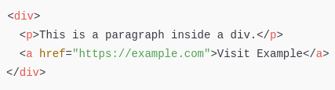

HTML
1. Tags
HTML documents are composed of tags enclosed in angle brackets (<tag>).
Common tags include:
<div>: A container for block-level content.
<span>: An inline container for text or other elements.
<p>: A paragraph of text.
<a>: A hyperlink to another page.
<img>: An image.
<table>: A table of data.
<ul> and <ol>: Unordered and ordered lists.
<li>: A list item.
. Attributes
Attributes provide additional information about elements. They are defined within the opening tag.
Common attributes:
id: A unique identifier for an element.
class: A class name that can be shared by multiple elements.
href: The URL in a hyperlink (<a> tag).
src: The source file for an image (<img> tag).
alt: Alternative text for images.

Slide 4
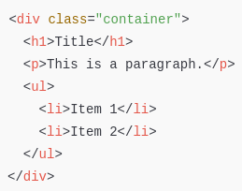
HTML
3. Heirarchy
In this example:
<div> is the parent of <h1>, <p>, and <ul>.
<ul> is the parent of <li> elements.
4. CSS Selectors
CSS selectors are used to style elements but are equally important for web scraping to identify elements.
ID Selector: Selects an element with a specific id.
#unique-id { color: red; }
Class Selector: Selects all elements with a specific class.
.class-name { font-size: 16px; }

Slide 5
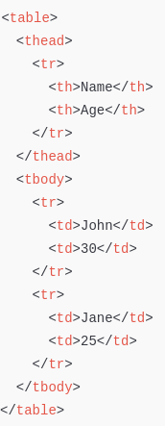
HTML
Tables represent tabular data, often used in web scraping for structured content.

Slide 6
HTML
When scraping:
Identify the Target Data:
Locate the element tags that hold the data (e.g., <div>, <span>, <table>).
Inspect Attributes:
Use attributes like id and class to pinpoint specific elements.
Leverage the Hierarchy:
Traverse the HTML tree to find nested elements.
Browser Developer Tools:
Right-click on a webpage and select "Inspect" to view its HTML structure.
Highlight Elements:
Use the "Select Element" tool to hover over and inspect specific parts of the page.

